Slide 1
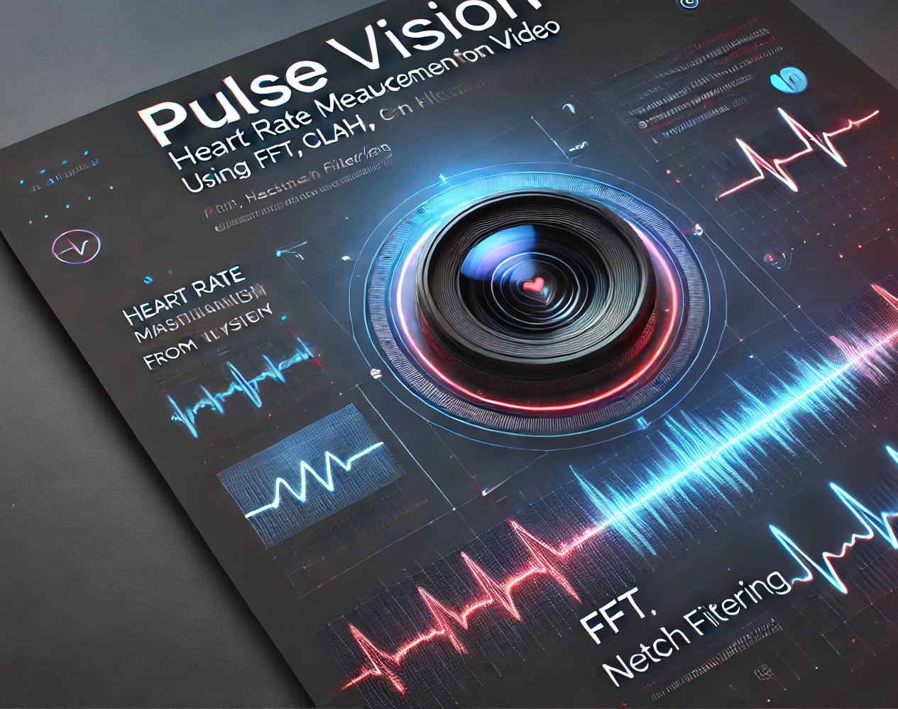
PulseVision
Video Based Heart Rate Measurement Using Variable Lighting
Presented By: Nadav Reubens
Ron Sisso
Supervised by:
Dr. Dan Lemberg
Mrs. Elena Kramer

Slide 2

Table of content
Project Recap: Purpose & problem solved
Existing rPPG Solutions & Limitations
Project Goal
System Pipeline Overview
FR & NFR Requirements
Test
Challenges
Results
Example

Slide 3
Our rPPG Project
Develop a non-contact heart rate monitoring system using a standard camera.
Use remote photoplethysmography (rPPG) - extracting pulse from subtle color changes in the face.
Traditional monitoring requires wearables or medical sensors, not always convenient or accessible.
Deliver real-time, accurate (±5 BPM) heart rate estimation, robust to lighting, motion, and environmental challenges.

Slide 4
Existing rPPG Solutions & Limitations
Wearables (watches, bands): accurate but require constant physical contact
Mobile apps: easy to use but uncomfortable (finger on camera/flash)
Research algorithms: work in labs, but fail in real-world lighting & motion
Often not real-time or need special hardware

Slide 5

Project Goal
Main Objective
Develop a real-time, non-contact heart rate monitoring system using only a camera.
Key Goals
Achieve ±5 BPM accuracy under normal conditions.
Ensure robustness against motion, lighting changes, and different skin tones.
Run at real-time speed (~30 FPS) on standard hardware.
Provide a user-friendly interface with patient data integration.

Slide 6
Full System Pipeline
Input Video
Face Detection
ROI Tracking
Green Channel Extraction
Multi-ROI Signal Combination
Signal Preprocessing
Heart Rate Estimation
Signal Quality Assessment
Heart Rate Filtering & Smoothing
GUI Display & Output

Slide 7
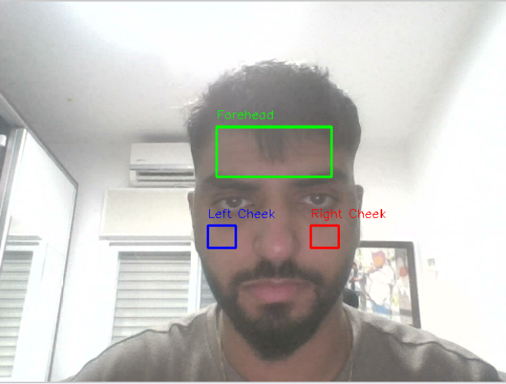
Face Detection & ROI
MediaPipe FaceMesh:
detects face with 468 landmarks
Extracted Regions of Interest (ROIs):
Forehead (main source of rPPG signal), Left Cheek, Right Cheek
Exponential Moving Average:
smooth ROI positions
Combine ROIs using dynamic weighting

Slide 8

Signal Preprocessing & Enhancement
General Features
Temporal smoothing → reduces random noise
Notch & bandpass filtering → removes flicker and isolates HR frequency band (0.8–3 Hz)
Robust normalization → stabilizes signal against outliers
Adaptive smoothing → adjusts filtering strength based on signal quality
Baseline correction → removes slow drifts from motion or lighting changes

Slide 9
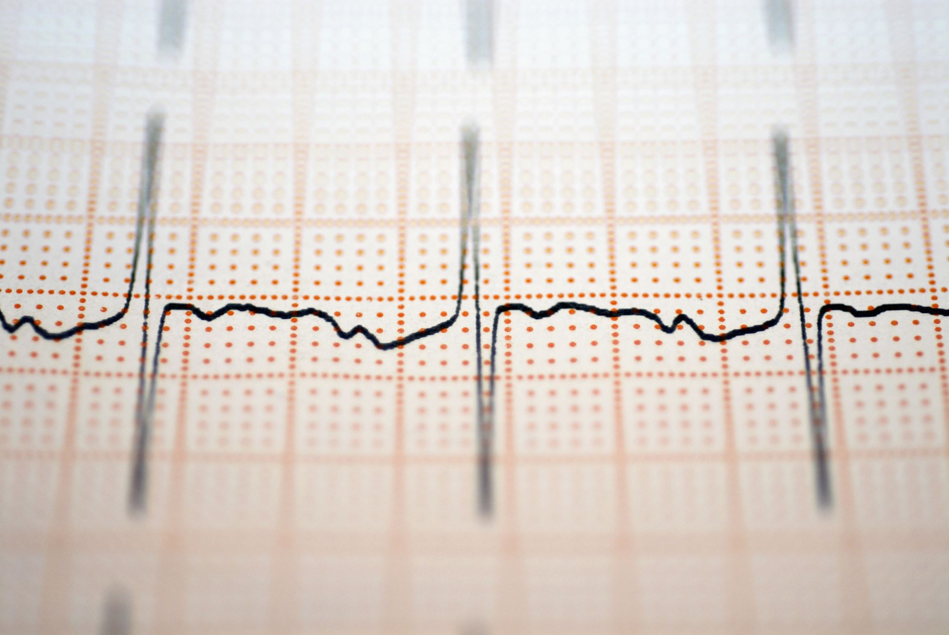
Heart Rate Estimation & Outlier Filtering
Heart Rate Estimation
Use Welch’s Power Spectral Density (PSD) to analyze frequency domain
Focus on 0.67–3.0 Hz (40–180 BPM) heart rate band
Outlier Filtering
Maintain a short rolling history of HR values
Use median reference for stability
Apply z-score method: reject abnormal values (|z| > 2.0)

Slide 10
Functional & Non-Functional Requirements
FR
NFR
Requirements | No.
The system must accept live camera feeds and recorded video files as input for heart rate extraction. | 1.
The system must detect the subject’s face and continuously track the region of interest (ROI) throughout the video. | 2.
The system must apply pre-processing techniques such as contrast enhancement and noise reduction to improve signal clarity. | 3.
The system must provide long-term monitoring, tracking heart rate fluctuations throughout the session. | 4.
Requirements | No.
The system must have a clear, user-friendly graphical interface that allows users to easily monitor their heart rate. | 1.
The system must provide heart rate readings with a maximum error margin of ±5 BPM, ensuring reliability comparable to medical-grade pulse oximeters. | 2.
The system must maintain consistent accuracy across different lighting conditions, skin tones, and facial orientations. It should compensate for LED flicker and sudden brightness changes to avoid measurement inaccuracies. | 3.

Slide 11
Testing
Result | Test
Successfully detected faces consistently across different skin tones, ages, and facial features | System accurately detects and locates faces across diverse populations
Heart rate remained stable, notch filtering effectively removed flicker artifacts | System maintains accurate heart rate readings despite artificial lighting flicker
Reliable HR extraction achieved in both controlled indoor lighting and natural outdoor light | System extracts HR data in various indoor/outdoor settings
Real-time HR display was clear, user-friendly, and easy to interpret | Users can clearly view and interpret HR data
* Tests conducted with ~20 subjects, ages 20–65

Slide 12

Key Challenges in rPPG
Motion Artifacts: Head turns, facial expressions, or small movements distort the signal.
Lighting Variability: Flicker from artificial lights, changing brightness indoor/outdoor.
Skin Tone Diversity: Signal strength varies across different populations.
Noise Sensitivity: Sudden spikes can produce false heart rate peaks.
Need for Ablation:
To understand which processing steps (e.g., smoothing, notch filters, normalization) are essential.
Helps identify the best configuration for stable, accurate HR under real-world conditions.

Slide 13
Results
Tested on ~20 subjects, ages 20–65
Accuracy within ±5 BPM of the ground truth heart rate
Robust across different lighting conditions (indoor, outdoor, artificial flicker)
Stable performance across diverse skin tones and facial features
Real-time operation at ~30 FPS on standard hardware

Slide 14

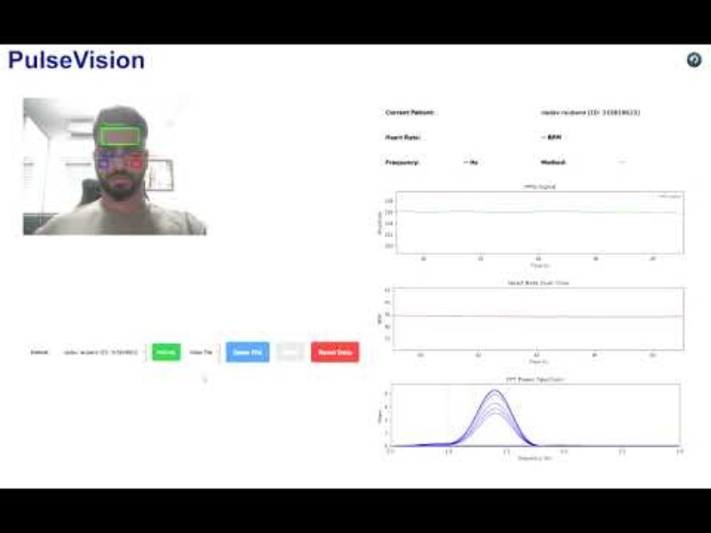
Example

Slide 15

Thank You For Listening!

